Slide 1

Automatic content generation based on Deep Learning within Unity plugin
Computer Vision and Deep Learning
Cappanera Simone
Pasqualini Michele

Slide 2
Index
Introduction
Unity
Object detection
Image classification
Results
Conclusion
Future works

Slide 3

Introduction
This work was carried out within the framework of XR4ALL which is a European project concerning eXtended Reality (XR)
(https://xr4all.eu/xr/). In particular, we focused on the integration between Augmeted Reality and Deep Learning.
In this project, object detection and image classification tasks were completed within an augmented reality application, built in Unity and based on Barracuda.

Slide 4
Introduction - Related works
A deep multi-scale CNN based approach capable of predicting and localizing the road course at night using camera sensors; [1]
A campus tour application utilizing advanced AR technologies, such as computer vision and object recognition. [2]
[1] Limmer M., Forster J., Baudach D., Schüle F., Schweiger R., Lensch H.P., "Robust deep-learning-based road-prediction for augmented reality navigation systems at night", 2016, IEEE 19th International Conference on Intelligent Transportation Systems (ITSC), IEEE (2016), pp. 1888-1895.
[2] Lin C.-H., Chung Y., Chou B.-Y., Chen H.-Y., Tsai C.-Y., "A novel campus navigation app with augmented reality and deep learning", 2018, IEEE International Conference on Applied System Invention (ICASI), IEEE (2018), pp. 1075-1077.

Slide 5

Unity
Unity is a cross-platform game engine developed by Unity Technologies, that has been gradually extended to support a variety of desktop, mobile, console and virtual reality platforms.

Slide 6
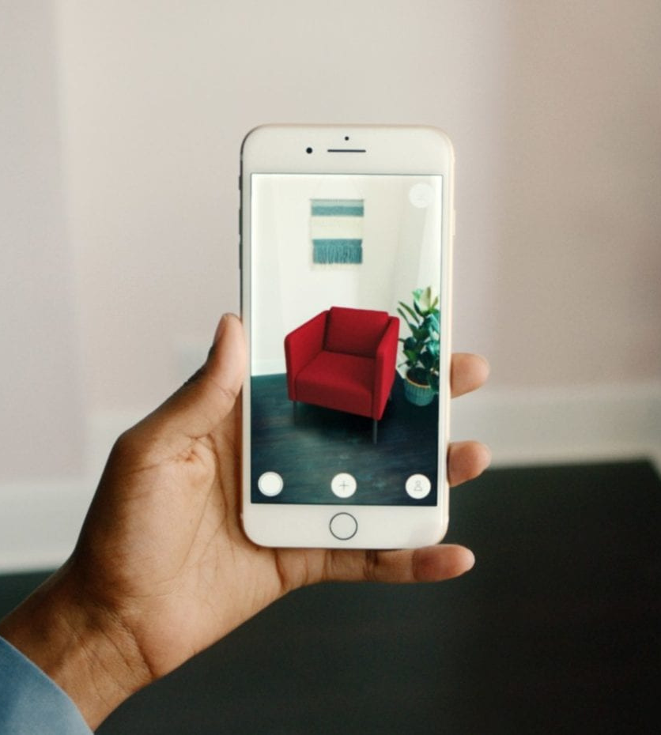
Unity - Augmented reality
Augmented reality is a field of computer research which deals with combination of reality with computer generated data.
AR is an enhanced version of the real physical world that is achieved through the use of digital visual elements, sound, or other sensory stimuli delivered via technology.

Slide 7
PRO:
Allow you to run neural networks within Unity
Unity - Barracuda
Cross-platform
The main tasks of the project have been implemented in the Unity framework thanks to the Barracuda package. Barracuda package is a lightweight cross-platform neural network inference library for Unity.
It can run neural networks fast on GPU
ONNX open source data exchange format
CONS:
OPENGL ES 3.x must be managed to use the CPU
Only some operators and parameters are allowed

Slide 8
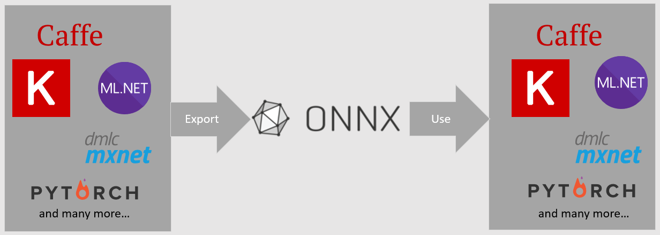
Unity - Barracuda
Open Neural Network Exchange (ONNX) is an open format built to represent machine learning models. ONNX defines a common set of operators and a common file format to enable AI developers to use models with a variety of frameworks.

Slide 9
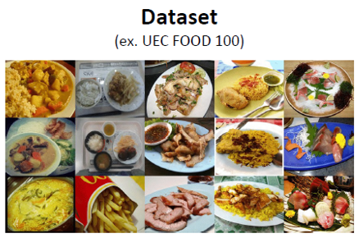
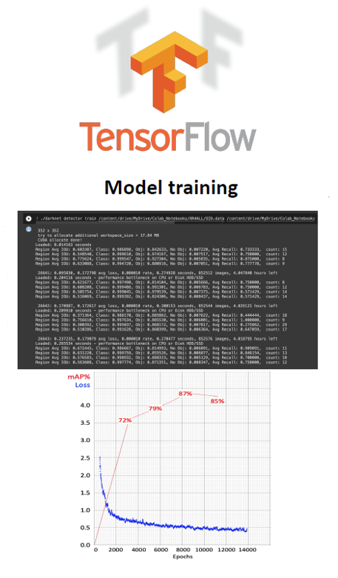
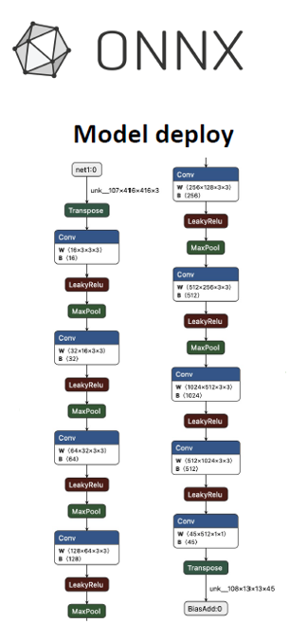
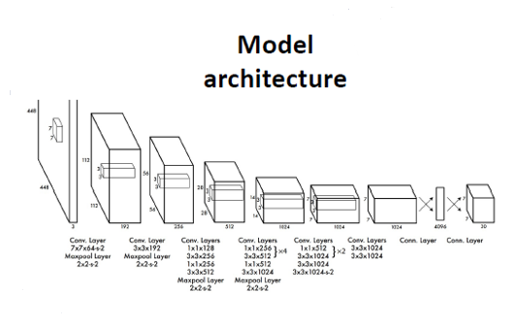
Unity - From NN to Barracuda
Workflow image to export a deep learning model trained in TensorFlow in Onnx format.
tf2onnx

Slide 10
Unity - AR with Barracuda
In this project we used Unity to develop an AR mobile application in real time, that implements some classic deep learning tasks.
In particular, the achieved tasks are:
Object detection;
Image classification.

Slide 11
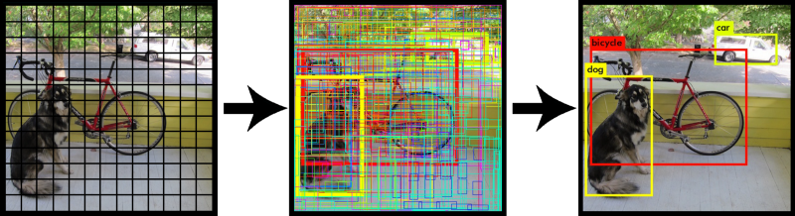
Object detection
Object detection is the task of detecting instances of objects of a certain class within an image.
In this project, the architectures used for this task are Tiny YOLOv2 and Tiny YOLOv3 [1].
[1] Redmon J., Divvala S., Girshick R., Farhadi A., "You Only Look Once: Unified, Real-Time Object Detection", 2015

Slide 12
Object detection
Tiny YOLOv2 and Tiny YOLOv3 have been used because:
the complexity of the architecture is reduced;
only some layers are supported by Barracuda.
Network
Parameters
Tiny YOLOv2
17.1 M
Tiny YOLOv3
8.7 M
YOLOv2
51 M
YOLOv3
65.2 M

Slide 13
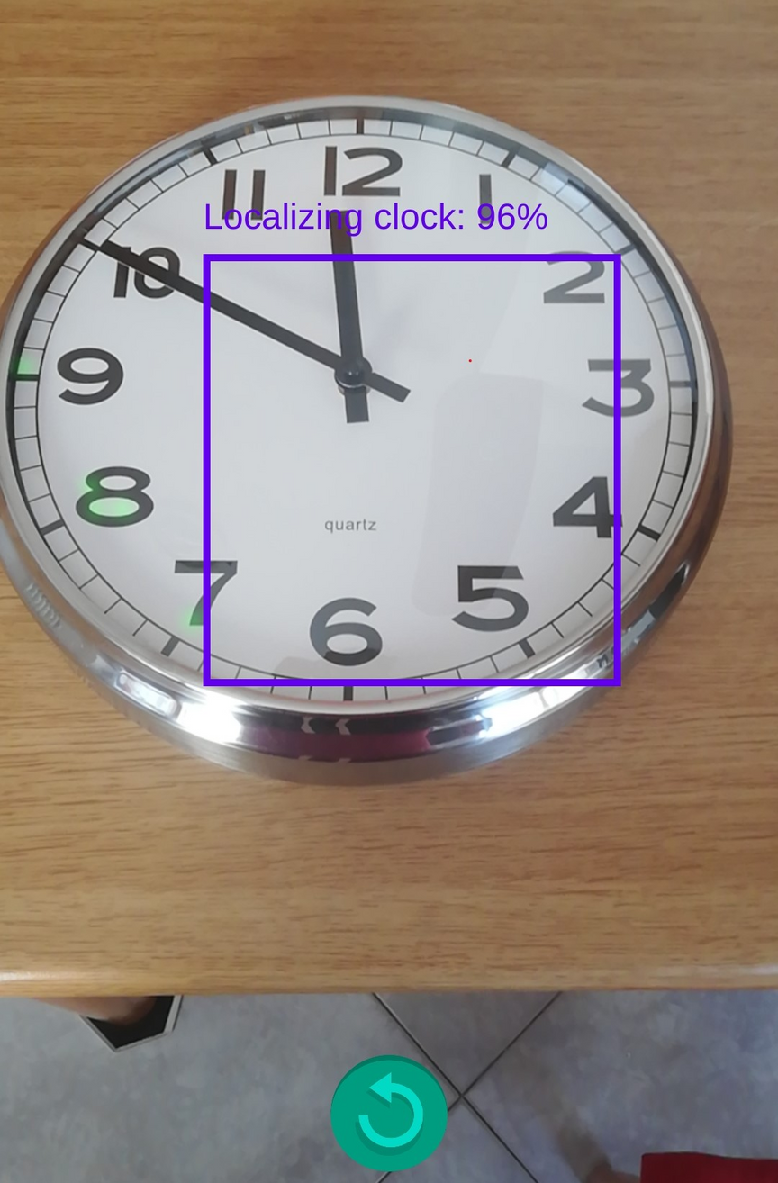
Object detection
Tiny YOLOv2 is trained on FOOD100 dataset. Ideally, it can detect 100 categories of dishes.
Instead, Tiny YOLOv3 is trained on COCO dataset that is a large-scale object detection, segmentation, and captioning dataset.

Slide 14
Image classification
The goal of image classification is to classify the image by assigning it to a specific label.
In this project, the architectures used for this task are MobileNetV1 and MobileNetV2 [1]. MobileNet uses depthwise separable convolutions.
[1] Howard A. G., Zhu M., Chen B., Kalenichenko D., Wang W., Weyand T., Andreetto M., Adam H., "MobileNets: Efficient Convolutional Neural Networks for Mobile Vision Applications", 2017

Slide 15
Image classification
MobileNetV1 and MobileNetV2 have been used because:
they are perfect for mobile devices, embedded systems, and more;
they significantly reduces the number of parameters;
only some layers are supported by Barracuda.
Network
Parameters
MobileNetV1
4.2 M
MobileNetV2
3.4 M
VGG16
138 M
DenseNet-121
7.2 M

Slide 16
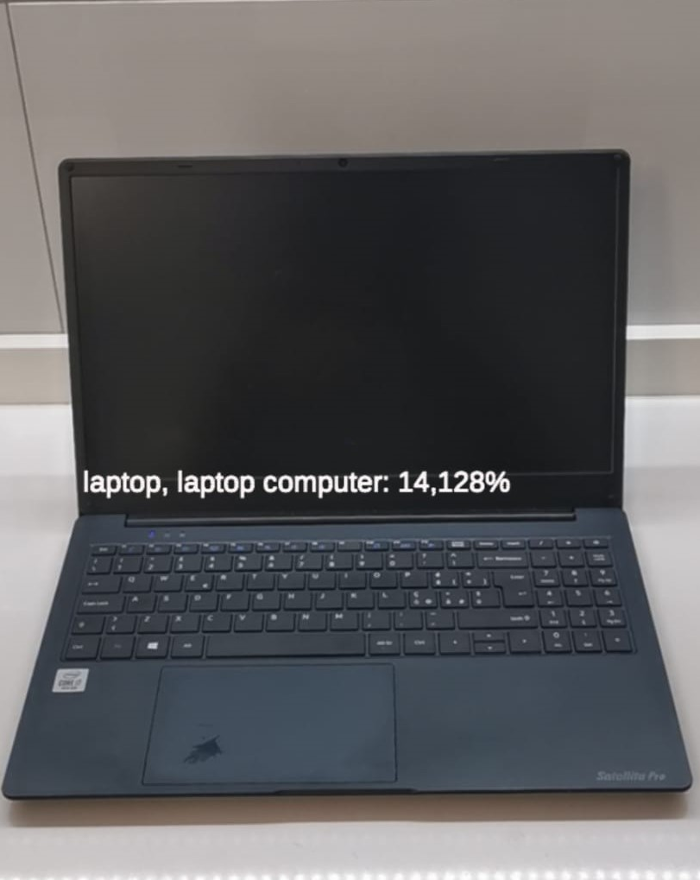
Image classification
MobileNetV1 and MobileNetV2 are trained on ImageNet dataset. It features millions of images classified into 1000 classes. It is the most important dataset for classification problems in convolutional neural networks.

Slide 17
Results
Model
Processor
Performance
GPU
Graphics memory size
Xiaomi MI 10 T
Snapdragon 888-series
High
Adreno (TM) 650
2048 byte
Xiamo Redmi Note 9 PRO
Snapdragon 7xx series
Mid
Adreno (TM) 618
2048 byte
Xiaomi Redmi Note 9 T
Mediatek 800 series
Mid
Mali-G57
1024 byte
Samsung Galaxy Note 20
Exynos 990 series
Mid to high
Mali-G77
2048 byte
Motorola One Fusion+
Snapdragon 730
Mid
Adreno (TM) 618
2048 byte

Slide 18
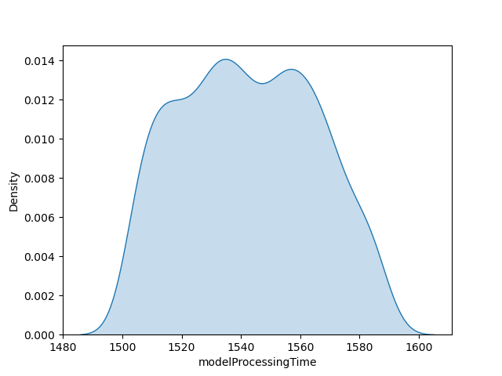
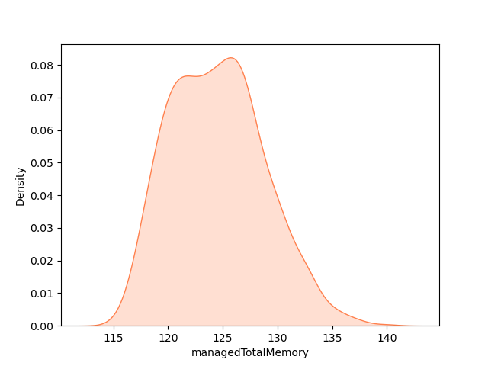
Results
Results on Adreno 618 GPU
The time needed by the physical devices to obtain the inference result from the model.
The total amount of RAM used by the application during the execution

Slide 19
Conclusion
Object detection
Image classification
Tiny YOLOv2 and Tiny YOLOv3 architectures detect objects with high accuracy
The application runs smoothly and without lag issues
MobileNetV1 has low confidence
The application is not very fluid
MobileNetV2 has higher confidence than V1

Slide 20
Future works
Implementation in an AR environment of new classic deep learning tasks, such as image segmentation.
Work on network pruning in order to find the right compromise between performance and computation.

Slide 21
Grazie per l'attenzione

